Slide 1
Status of the evaluation of n + ⁵⁶Fe reaction data
Focus on (n,inl)
Meeting INDEN, IAEA, Vienna, 14-18 December 2020
M. DIAKAKI, G. NOGUERE, P. TAMAGNO, E. VANDERMEERSCH

Slide 2
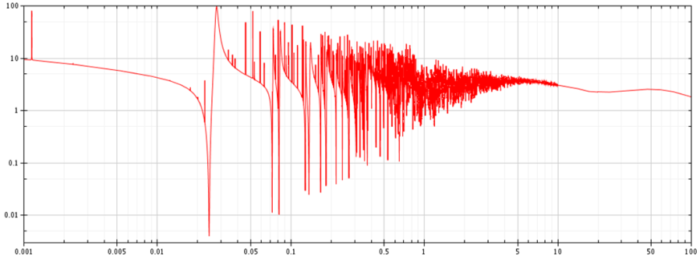
OUTLINE
Motivation: CIELO project (complete evaluation of all Fe isotopes): very difficult to extend RRR to higher energies than the initial Froehner evaluation (1977).
Goal: Complete evaluation of ⁵⁶Fe, from RRR to continuum, with consistent uncertainties treatment.
The CONRAD code used, an object oriented evaluation platform developed at CEA Cadarache.
<5MeV: Fluctuations difficult to describe with any model
>5MeV: Optical model calculations
Current RRR limit:
850 keV
Studied
in the CIELO project,
not retained
Meeting INDEN, IAEA, Vienna, 14-18 December 2020

Slide 3
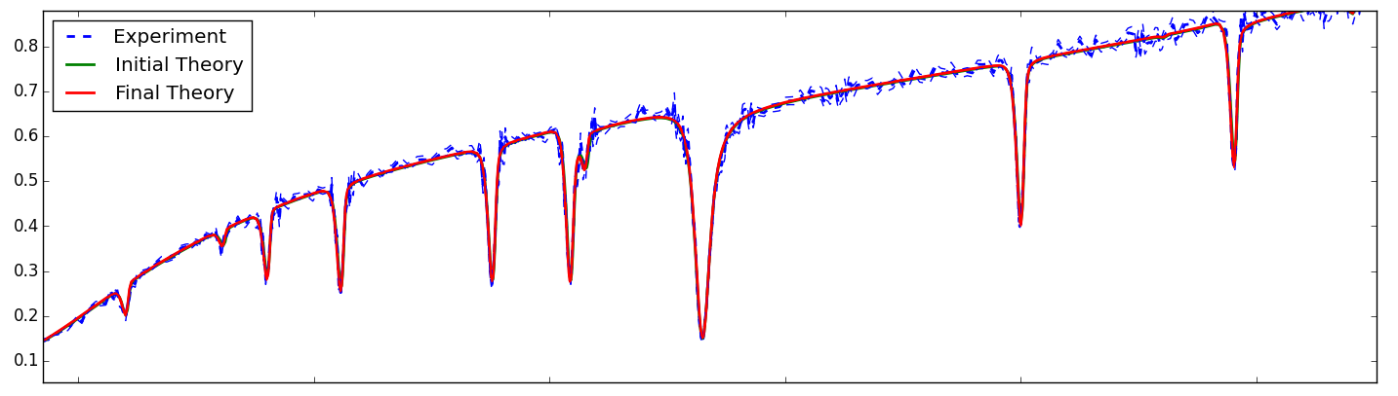
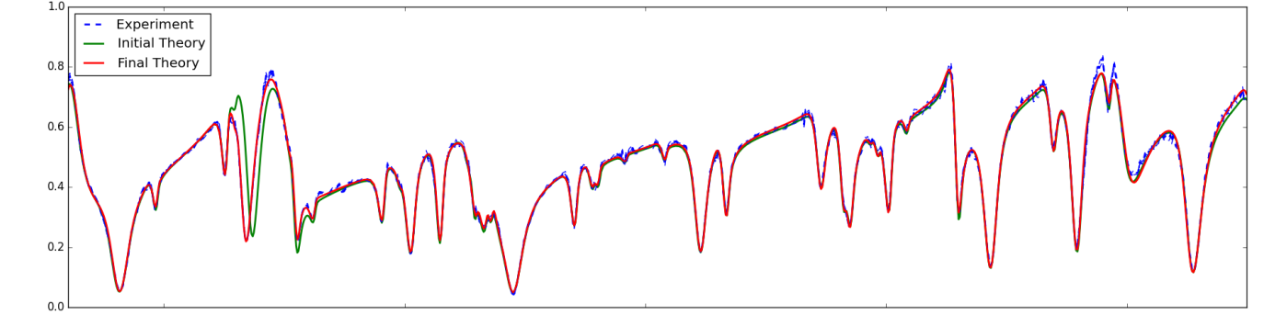
Resolved Resonances Region (up to 850keV)
JEFF 3.1.1 used as a basis
(Froehner’s evaluation, no information on parameter uncertainties)
Used experiments with sufficient number of points to nicely describe peaks
Current RRR limit:
850 keV
Determination of specific characteristics of each
measurement (Resolution function, Contaminations,
Normalisation factor etc.)
General confirmation of RRP (even for L>0
resonances) apart from some issues.
280000
290000
300000
Energy (eV)
Transmission Fe56 - Perey (1991)
Meeting INDEN, IAEA, Vienna, 14-18 December 2020

Slide 4
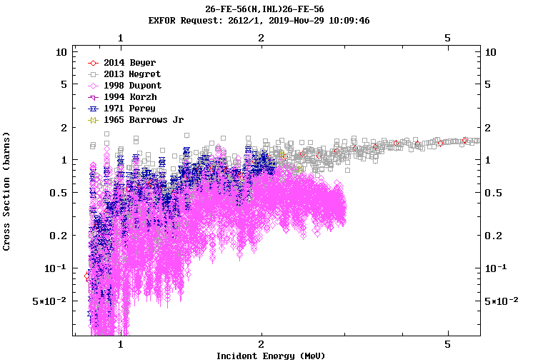
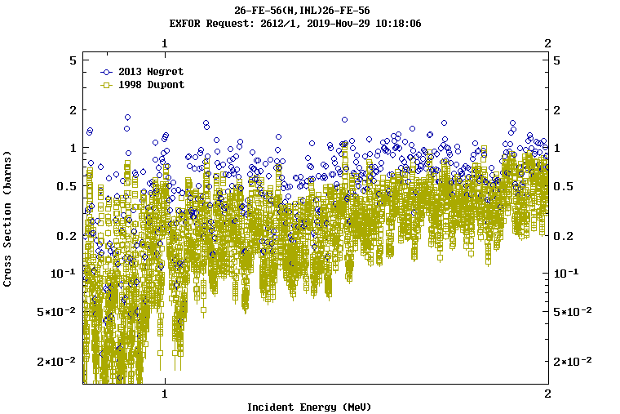
Extend RRR?
Effort to extend RRR above 850 keV.
Initial RRP from CIELO project (Luiz Leal, ORNL4): fe56ib04.endf (available at www-nds.iaea.org/CIELO)
(n,inl): For the moment mainly data from Negret (2013) and Perey (1971) (data from Dupont (1998) had normalisation issues but better resolution, so used only to find position of added peaks).
Meeting INDEN, IAEA, Vienna, 14-18 December 2020

Slide 5
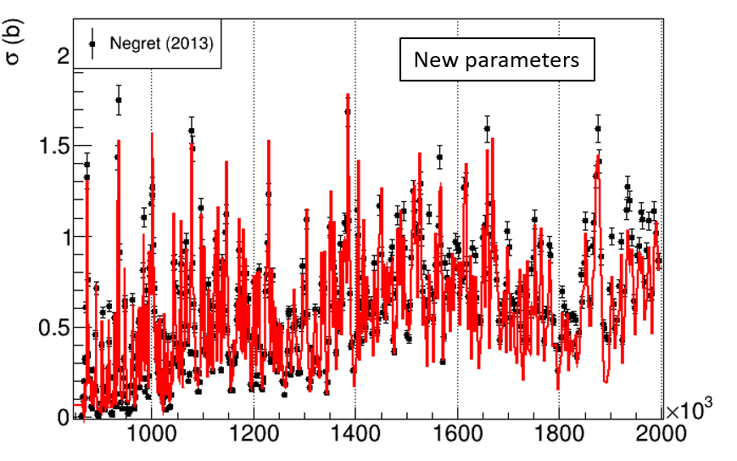
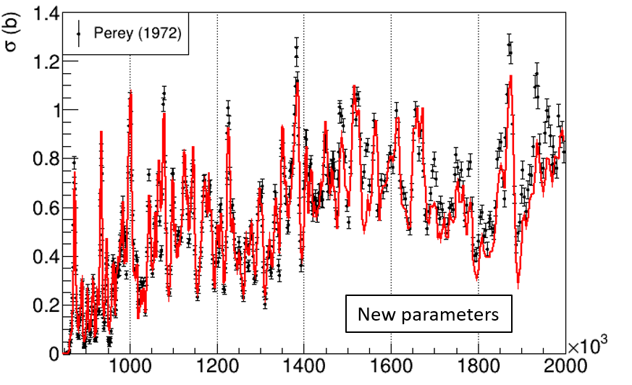
56Fe(n,inl)
=> New preliminary RRPs (no normalisation of inelastic datasets):
When going up in energy the more difficult it gets to add resonances to reproduce the inelastic without spoiling the transmission datasets’ reproduction => Too high inelastic or need to change the elastic??
To be continued…
Meeting INDEN, IAEA, Vienna, 14-18 December 2020

Slide 6
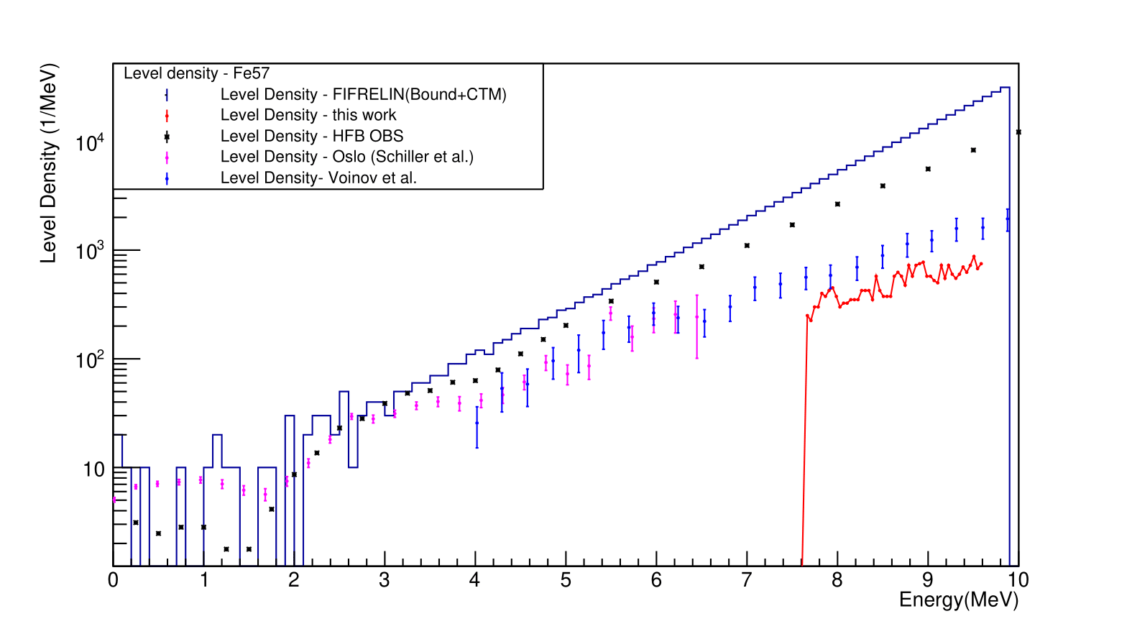
STATISTICAL ANALYSIS OF RESONANCES
experimental
New
resonances
Sn
Slope important not the normalisation factor
Maybe can be used to cross-check above which energy we start losing resonances.
Looking for more statistical checks that can be used..

Slide 7


THE PERLE EXPERIMENT* for validation
EOLE REACTOR @ CEA CADARACHE
Stainless steel reflector (20cm)
Main purpose: Validation of Fe nuclear data.
Dosimeters (metallic activation foils) + Fission chambers along the reflector: Flux attenuation measurements.
Top view of the EOLE core:
Dosimeter reactions | Fission Chamber reactions
197Au(n,γ) | 235U(n,f)
115In(n,γ) | 238U(n,f)
55Mn(n,γ) | 237Np(n,f)
115In(n,n’)
56Fe(n,p)
27Al(n,α)
Different neutron energy responses : Thermal, epithermal, intermediate, fast.
(also change with respect to the position along reflector)
*C. Vaglio-Gaudard et al., Nuclear Science and Engineering, 166:2, 89-106
Meeting INDEN, IAEA, Vienna, 14-18 December 2020
Notes:
UO₂ fuel pins, Zr cladded, pitch 1.26cm

Slide 8
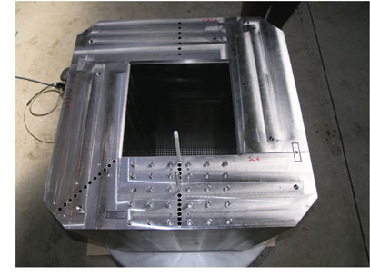

NUCLEAR DATA VALIDATION AT PERLE:
Calculation (C)
Interpretation with Monte Carlo code TRIPOLI-4*:
For position i: $\frac{RR\left(position i\right)}{RR(position 0)}$
Experiment (E)
Comparison Calculation - Experiment of neutron fluence
attenuation through the stainless steel reflector (C/E-1)
* E. Brun et al, Annals of Nuclear Energy, Volume 82, pp. 151-160, 2015.
Meeting INDEN, IAEA, Vienna, 14-18 December 2020

Slide 9
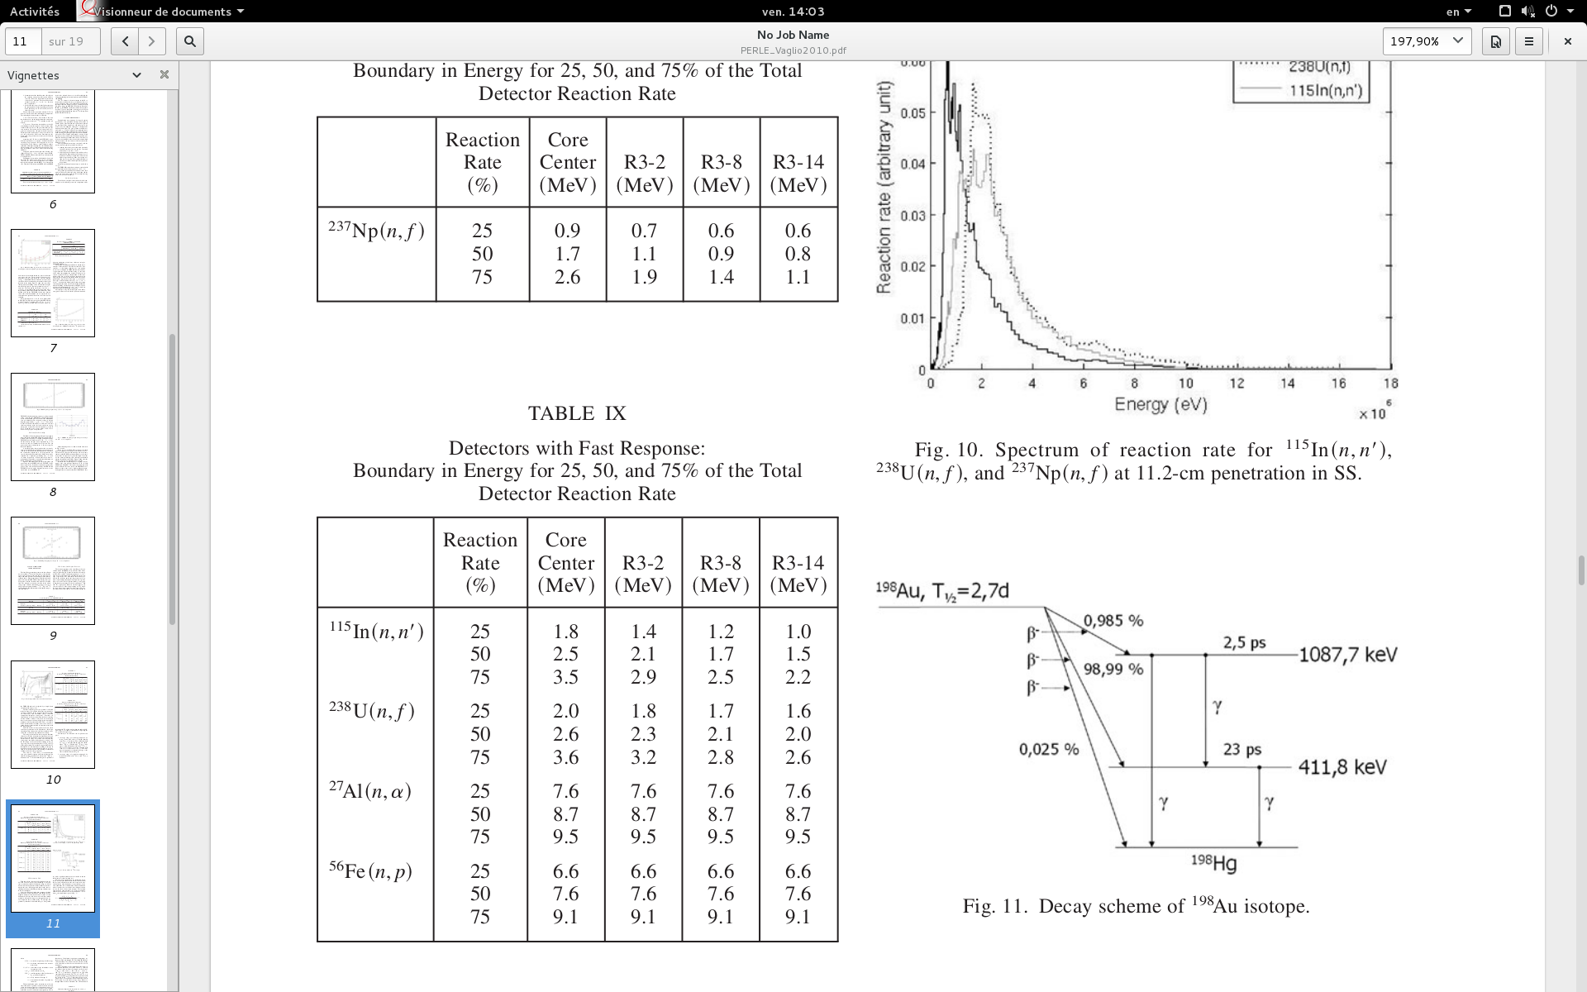
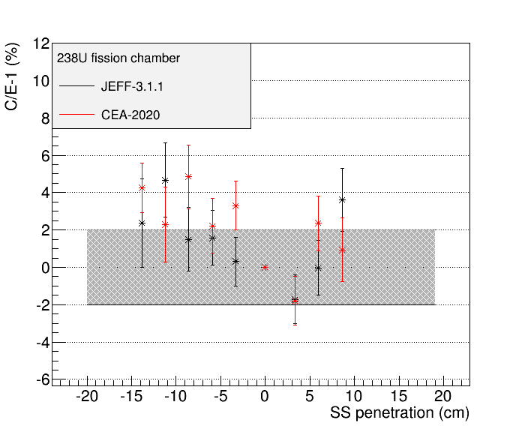
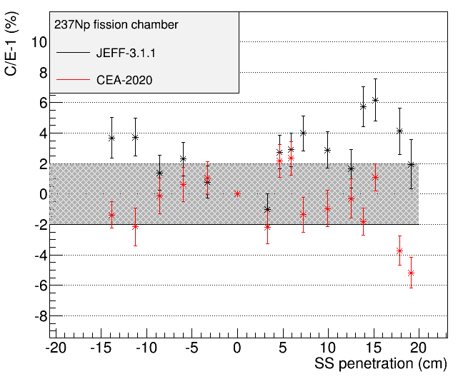
NUCLEAR DATA VALIDATION AT PERLE:
Test new RRP evaluation file :
Intermediate and fast energy region:
Meeting INDEN, IAEA, Vienna, 14-18 December 2020
9

Slide 10
FURTHER WORK
Ongoing effort to extend RRR to the highest energy limit.
Description of fluctuations between 2 and 5MeV.
Check evaluation results on integral experiments we have available.
New PhD thesis starts in 2021 to work on the new campaign of 56Fe microscopic measurements at GELINA with enriched sample ((n,el), (n,inl), (n,tot),(n,γ)..)
+++++
Meeting INDEN, IAEA, Vienna, 14-18 December 2020

